Slide 1

PASSWORD MANAGER
RA2211003010836 ROSHNI BANERJEE
RA2211003010848 RISA PANDEY
RA2211003010855 SNEHA GHOSH

Slide 2

ABSRACT:
Password Manager”
is a small-scale project used for storing yourlogininformation for all the websites you use and generating random passwordsfor users. The user will have the access to add, update and remove his detailsand he can fetch his data whenever needed.It’s an GUI based application simple and easy to use. It has a lot’s of feature which makes user experience better. In this applicationPasswordscan be stored for various applications and details required for maintainingthe Passwords areapplicationor website name, username, password andemail id.You would not get any problem while using it because it’s simple anduser friendly UI will make your work easy, faster and gives you a betterresult.
“Password Manager” is a small-scale project used for storing your login information for all the websites you use and generating random passwords for users. The user will have the access to add, update and remove his details and he can fetch his data whenever needed. It’s an GUI based application simple and easy to use. It has a lot’s of feature which makes user experience better. In this application Passwords can be stored for various applications and details required for maintaining the Passwords areapplication or website name, username, password and email id. You would not get any problem while using it because it’s simple and user friendly UI will make your work easy, faster and gives you a better result.

Slide 3
INTRODUCTION :
Password Manager is an GUI based application that allows users to store andgenerate random passwords. It is created in Python using Tkinter and Mysqldatabase to manage passwords for several application. A password manager is a program that houses all your passwords, as well as other information, inone convenient location with one master password.The benefits of using Password Manager are:

A Password Manager will do the work of creating the complicated passwords you need to help protect your online accounts.

You need to remember only the password manager’s password. Thatsingle password will give you access to all of your others. Not only do password managers help securely house your passwords, butthey can also generate passwords that are unique and complex, which makesthem more difficult to crack or guess. It also simplifies your life by makingaccount access easier for you and more diffifcult for hackers. You don’t have to memorize any passwords except for the password to your passwordmanager.That means you can actually follow unpleasant butuseful security advice, likenever reusing a password and always using long, strong and complex passwords.
[1]
Password Manager is an GUI based application that allows users to store and generate random passwords. It is created in Java using Tkinter to manage passwords for several application. A password manager is a program that houses all your passwords, as well as other information, in one convenient location with one master password. The benefits of using Password Manager are:
A Password Manager will do the work of creating the complicated passwords you need to help protect your online accounts.
You need to remember only the password manager’s password. That single password will give you access to all of your others. Not only do password managers help securely house your passwords, but they can also generate passwords that are unique and complex, which makes them more difficult to crack or guess. It also simplifies your life by making account access easier for you and more diffifcult for hackers. You don’t have to memorize any passwords except for the password to your password manager. That means you can actually follow unpleasant but useful security advice, like never reusing a password and always using long, strong and complex passwords..

Slide 4
DIFFERENT APPLICATION USED :
Password Manager is an GUI based application that allows users to store andgenerate random passwords. It is created in Python using Tkinter and Mysqldatabase to manage passwords for several application. A password manager is a program that houses all your passwords, as well as other information, inone convenient location with one master password.The benefits of using Password Manager are:

A Password Manager will do the work of creating the complicated passwords you need to help protect your online accounts.

You need to remember only the password manager’s password. Thatsingle password will give you access to all of your others. Not only do password managers help securely house your passwords, butthey can also generate passwords that are unique and complex, which makesthem more difficult to crack or guess. It also simplifies your life by makingaccount access easier for you and more diffifcult for hackers. You don’t have to memorize any passwords except for the password to your passwordmanager.That means you can actually follow unpleasant butuseful security advice, likenever reusing a password and always using long, strong and complex passwords.
[1]
JButton: The JButton class is used to create a labeled button that has platform independent implementation
JLabel: The object of JLabel class is a component for placing text in a container.
JRadioButton: The JRadioButton class is used to create a radio button.
JOptionButton: The JOptionPane class is used to provide standard dialog boxes such as message dialog box, confirm dialog box and input dialog box.
JScrollbar: The object of JScrollbar class is used to add horizontal and vertical scrollbar.
JTextField: The object of a JTextField class is a text component that allows the editing of a single line text.

Slide 5

OBJECTIVES:
Password Manager”
is a small-scale project used for storing yourlogininformation for all the websites you use and generating random passwordsfor users. The user will have the access to add, update and remove his detailsand he can fetch his data whenever needed.It’s an GUI based application simple and easy to use. It has a lot’s of feature which makes user experience better. In this applicationPasswordscan be stored for various applications and details required for maintainingthe Passwords areapplicationor website name, username, password andemail id.You would not get any problem while using it because it’s simple anduser friendly UI will make your work easy, faster and gives you a betterresult.
In this project, we will build an application which will store the User's password, as well as other information, in one convenient location with one master password. Java Features and methods are used to implement in this project. Today, people have a large number of passwords for social media sites, work logins, shopping pages, online banking and much more. While it is important to use strong passwords and to use different passwords on each site, it can be a difficult task to remember all them. With a password manager, you simply enter the GUI app, provide the master password you set for the password manager in that software, then log in to the GUI app and the username and password will be stored for you. However, the primary purpose of this project to make Password Manager application user-friendly so that any individual can interact with the system.

Slide 6

SCOPE:
Password Manager”
is a small-scale project used for storing yourlogininformation for all the websites you use and generating random passwordsfor users. The user will have the access to add, update and remove his detailsand he can fetch his data whenever needed.It’s an GUI based application simple and easy to use. It has a lot’s of feature which makes user experience better. In this applicationPasswordscan be stored for various applications and details required for maintainingthe Passwords areapplicationor website name, username, password andemail id.You would not get any problem while using it because it’s simple anduser friendly UI will make your work easy, faster and gives you a betterresult.
The main scope and deliverables of the project would be to:
Understand and prepare detailed user requirement and specifications.
Prepare high level and detailed design specifications of the system.
Prepare Test Plan & Test cases.
Develop the system and coding.
Perform unit testing, integration testing and system testing.
Demonstrate a bug free application after suitable modification, if needed.
Develop a GUI application using Java Tkinter.

Slide 7
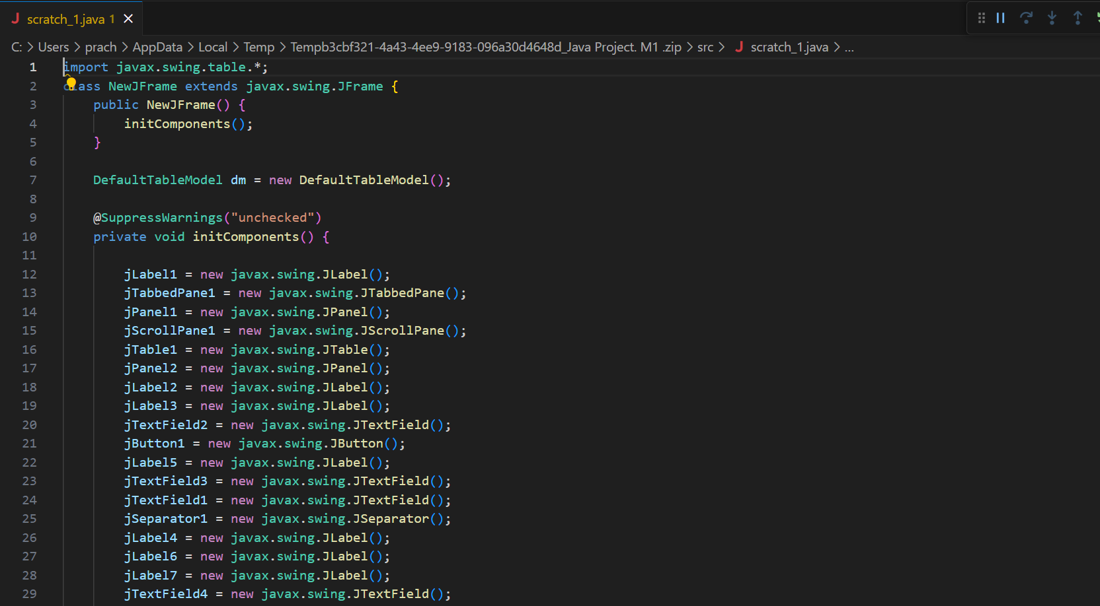
Code:-

Slide 8
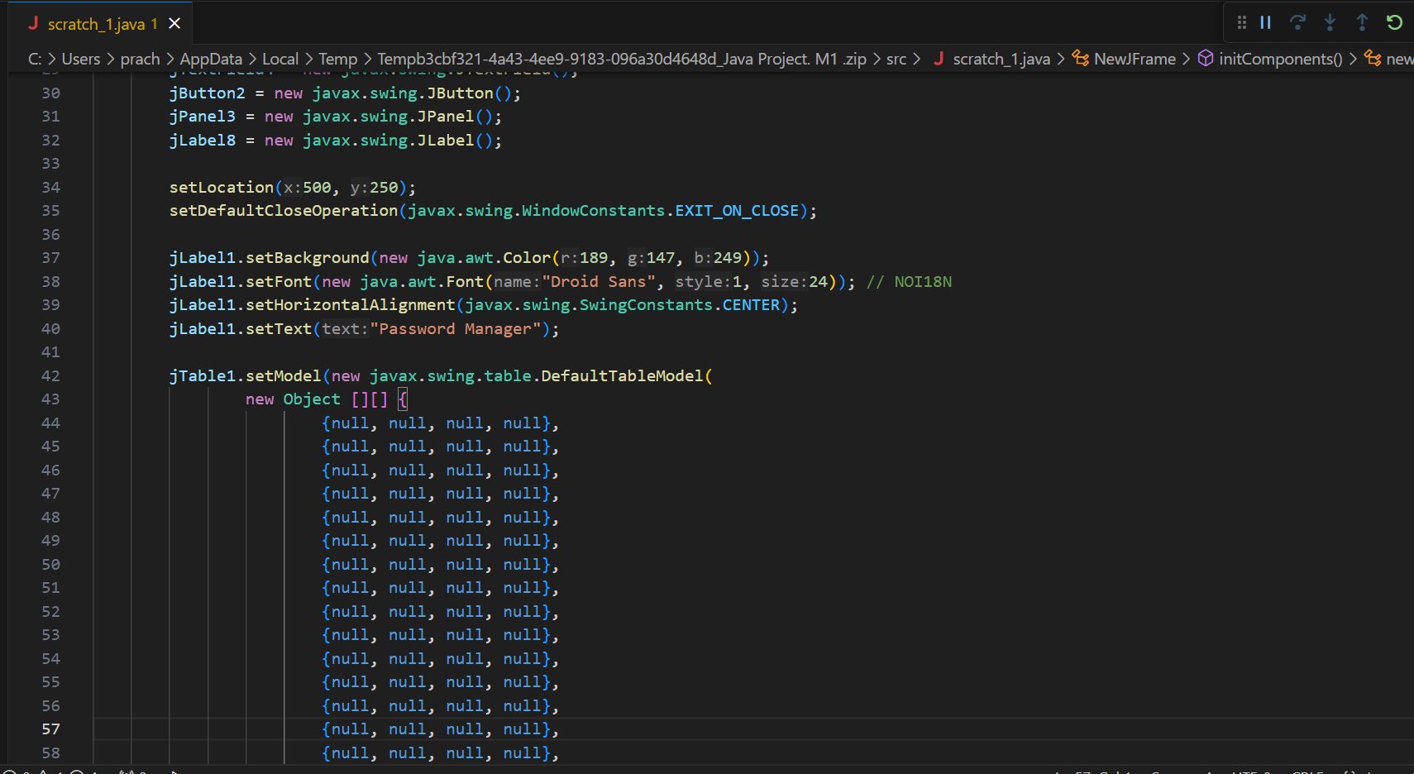
Code:-

Slide 9
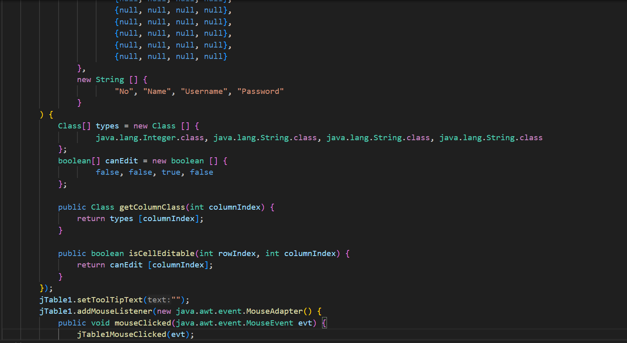
Code:-

Slide 10
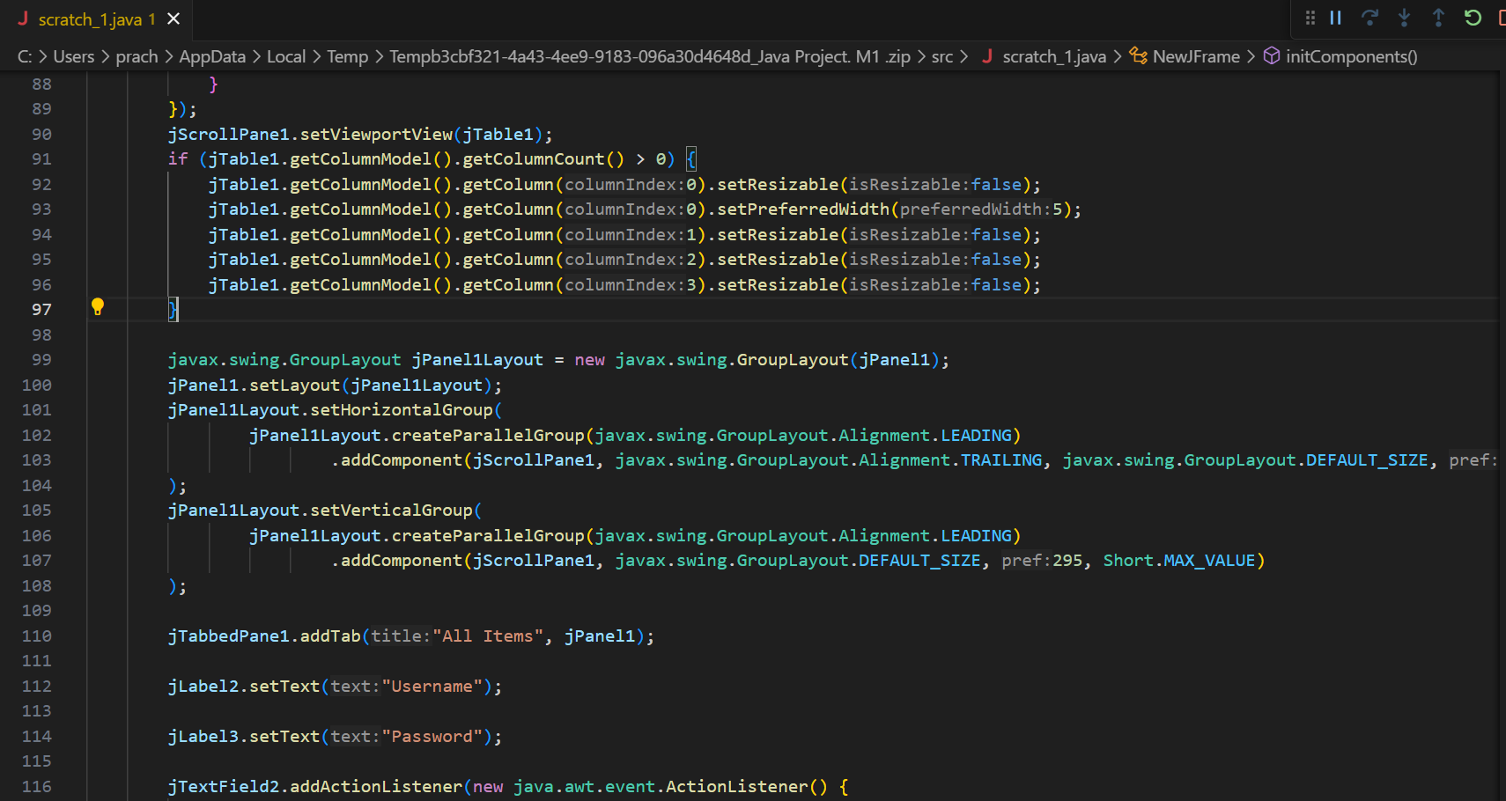
Code:-

Slide 11
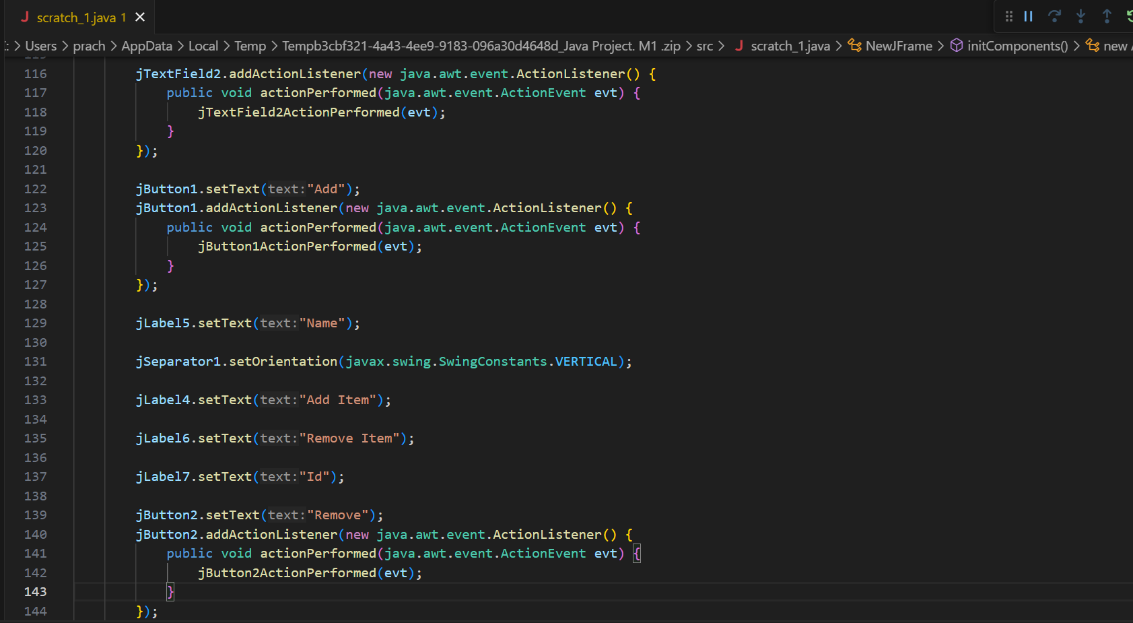
Code:-

Slide 12
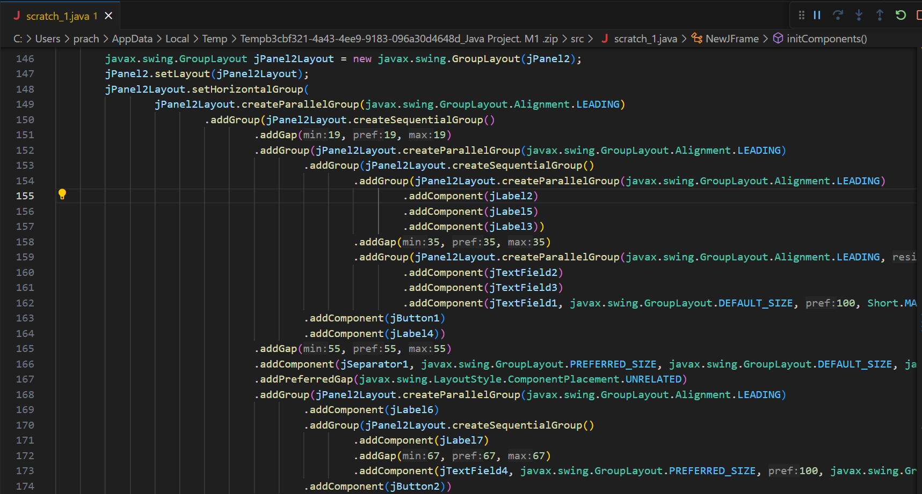
Code:-

Slide 13
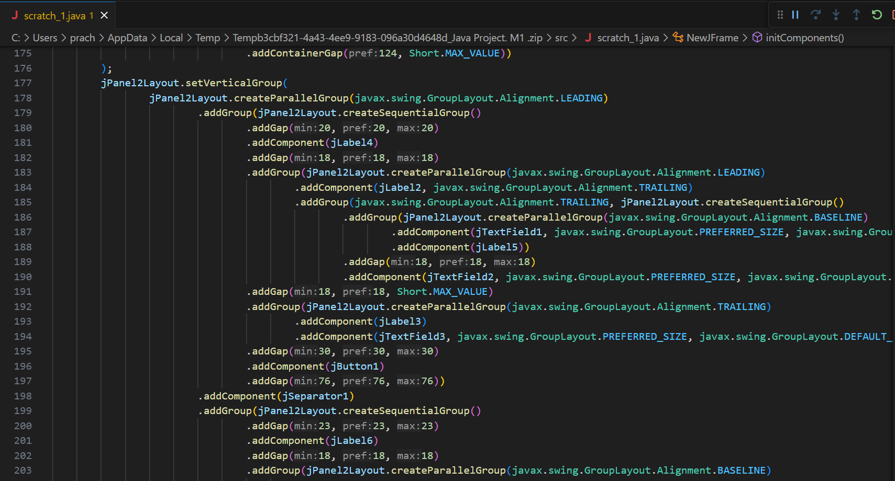
Code:-

Slide 14
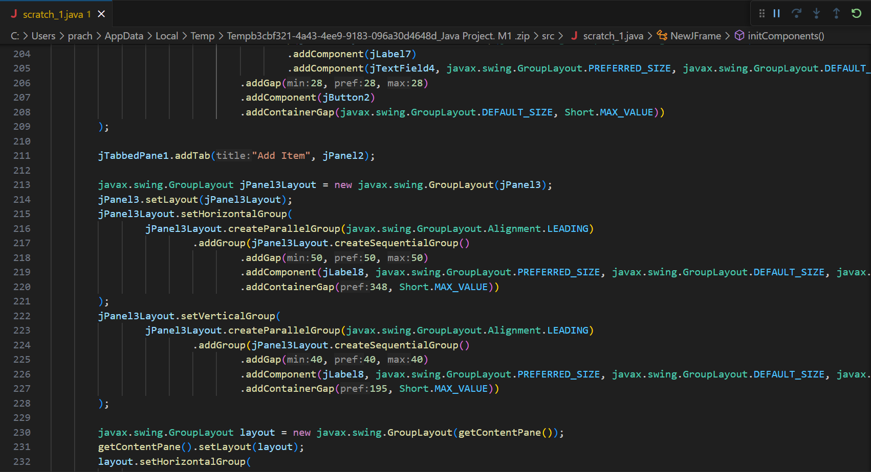
Code:-

Slide 15
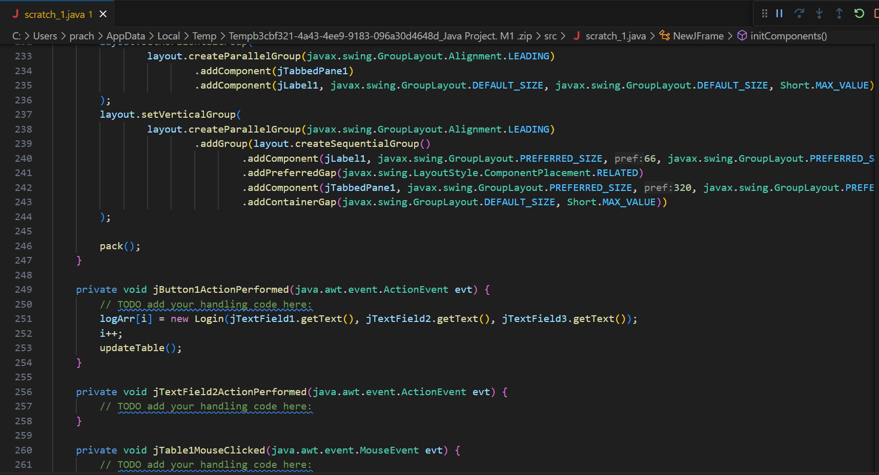
Code:-

Slide 16
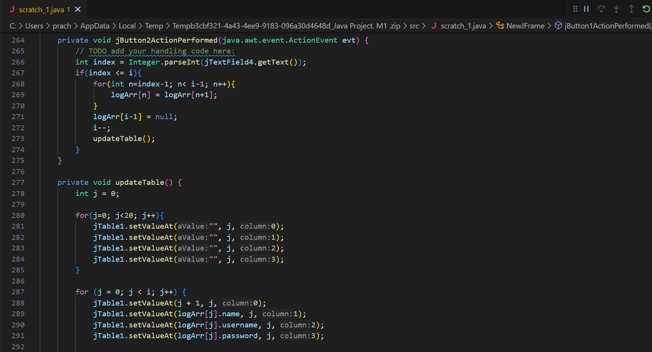
Code:-

Slide 17
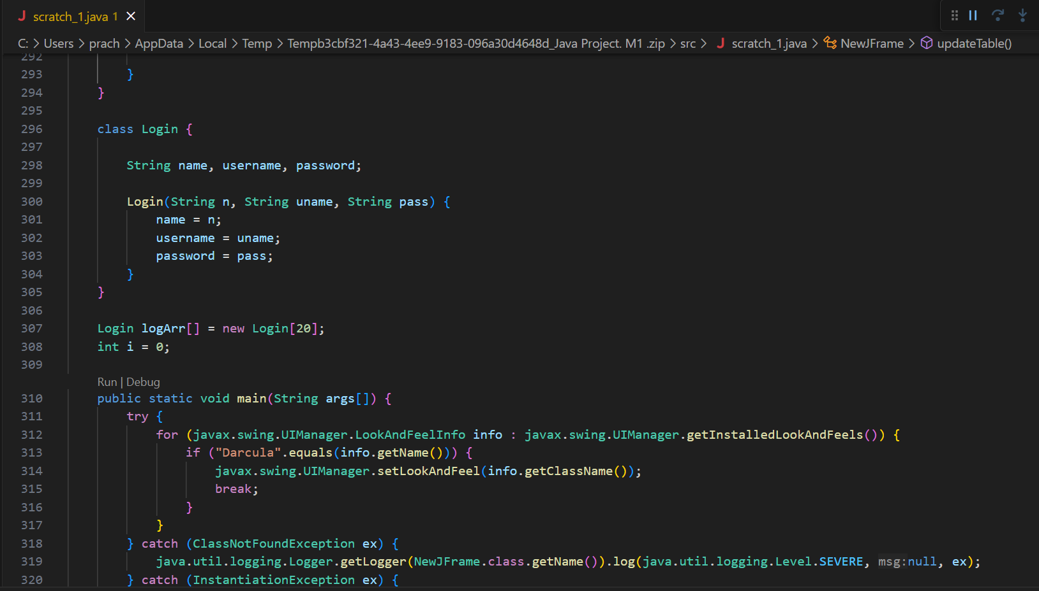
Code:-

Slide 18
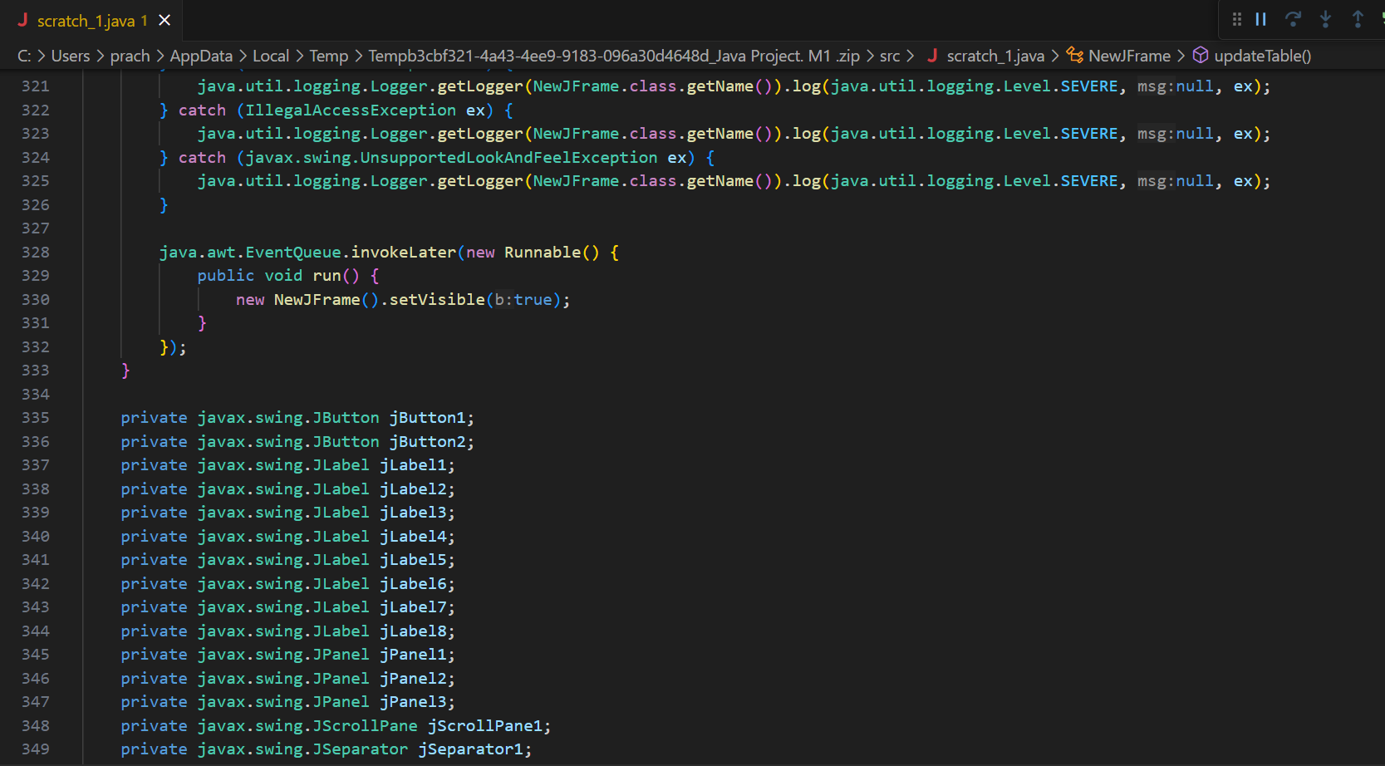
Code:-

Slide 19
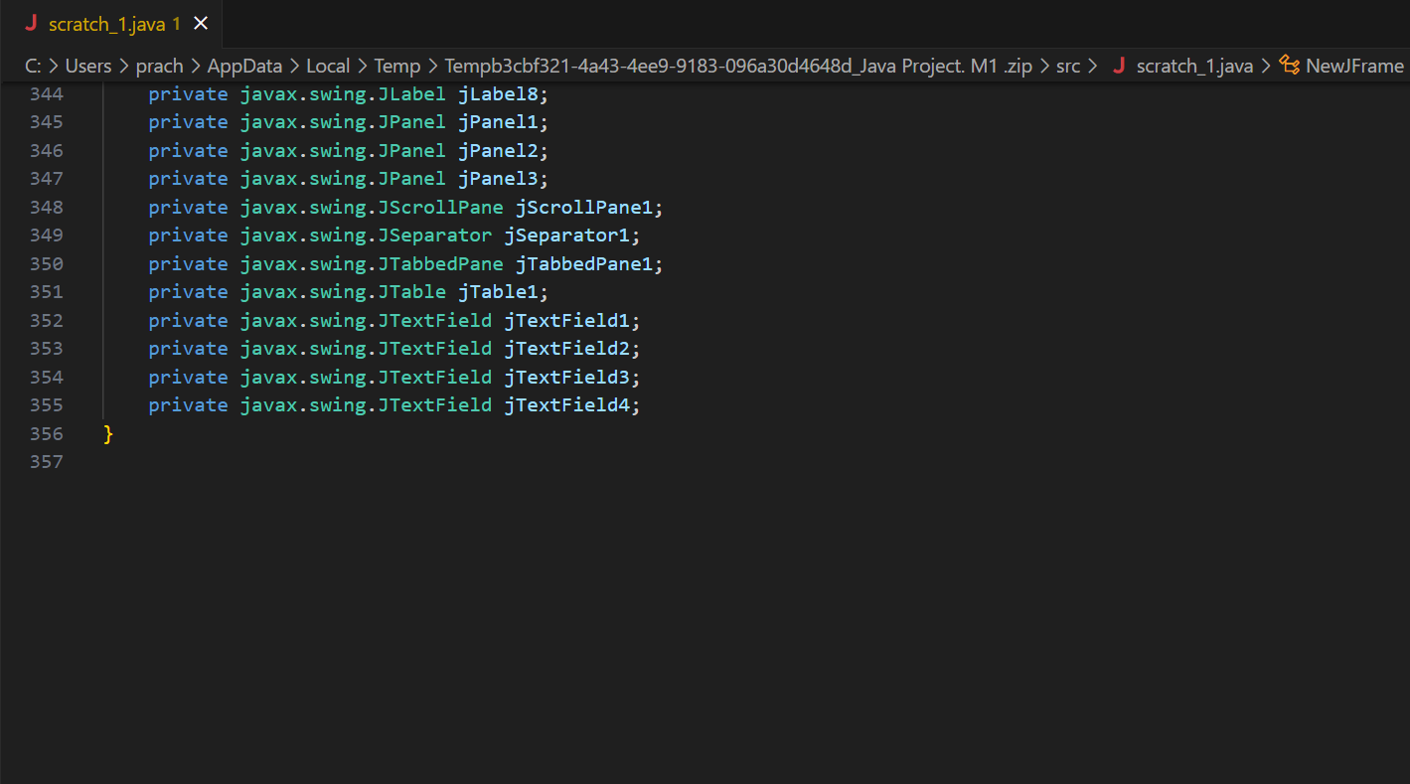
Code:-

Slide 20
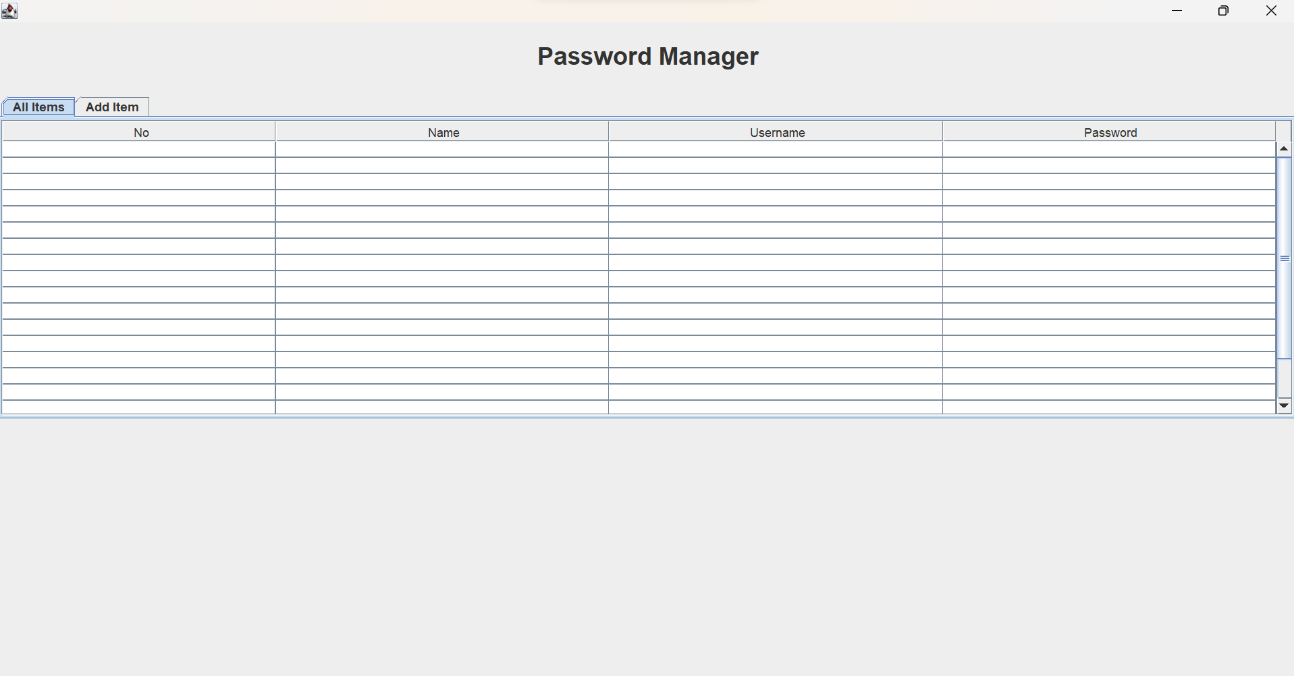
Output:-

Slide 21
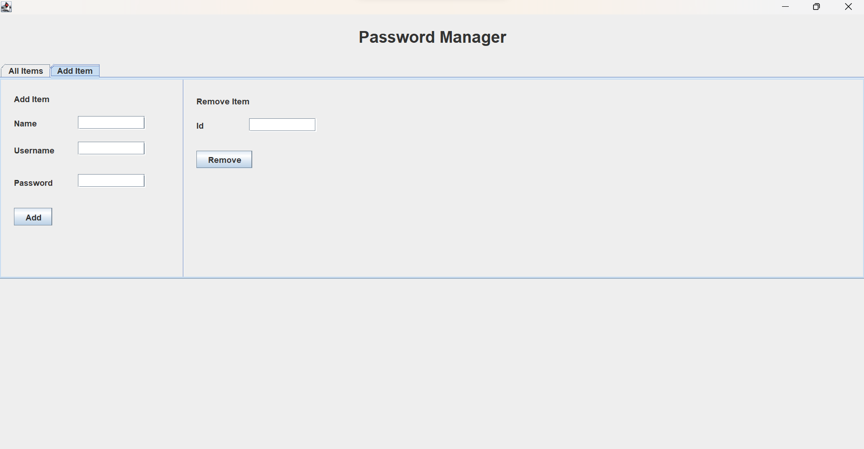
Output:-

Slide 22
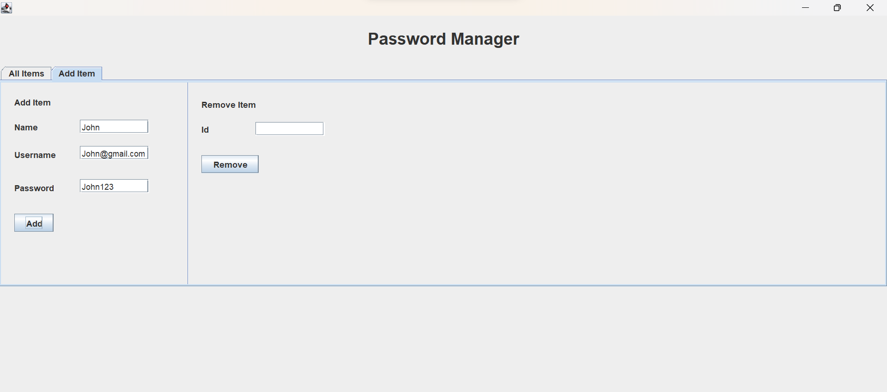
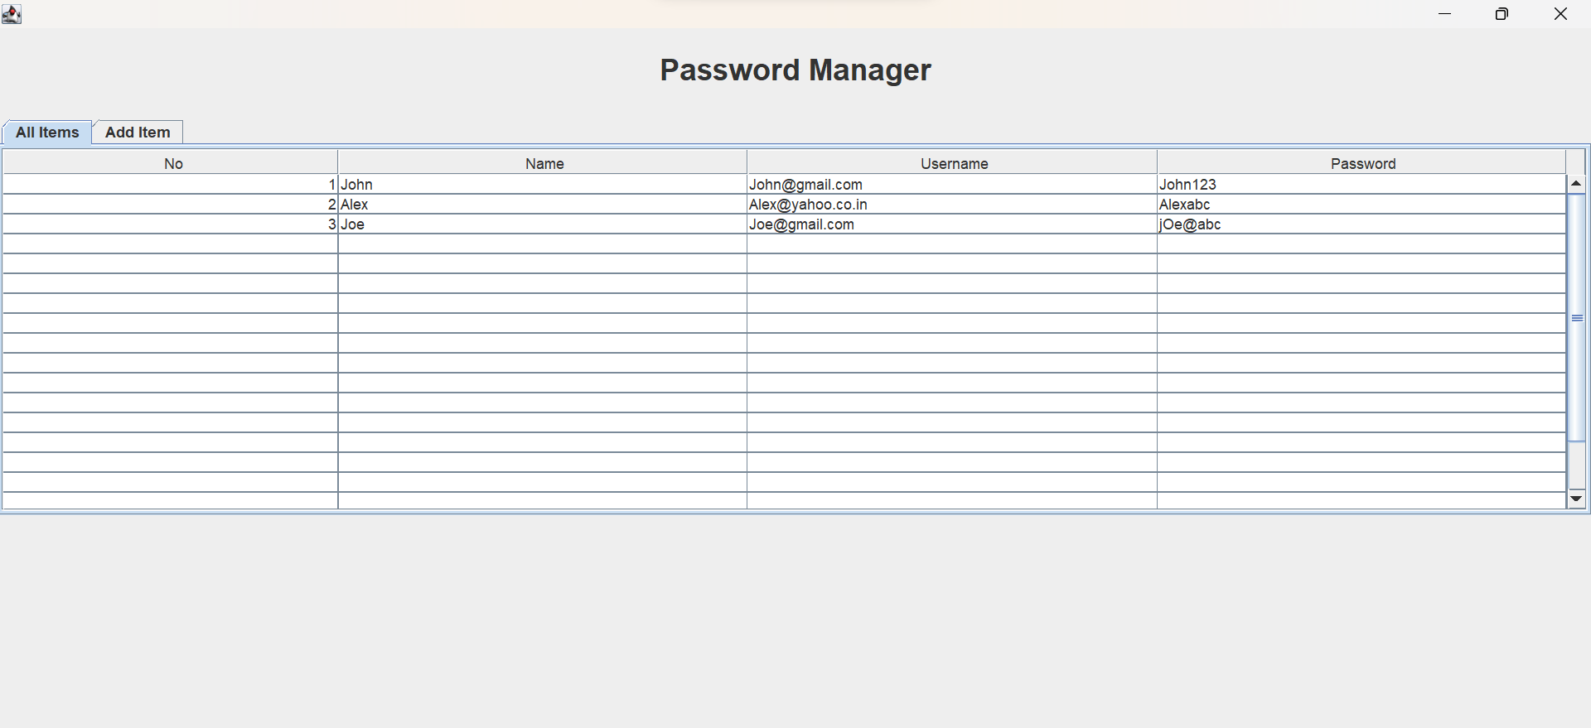
Output :
ADDING A NEW RECORD
DISPLAYING

Slide 23
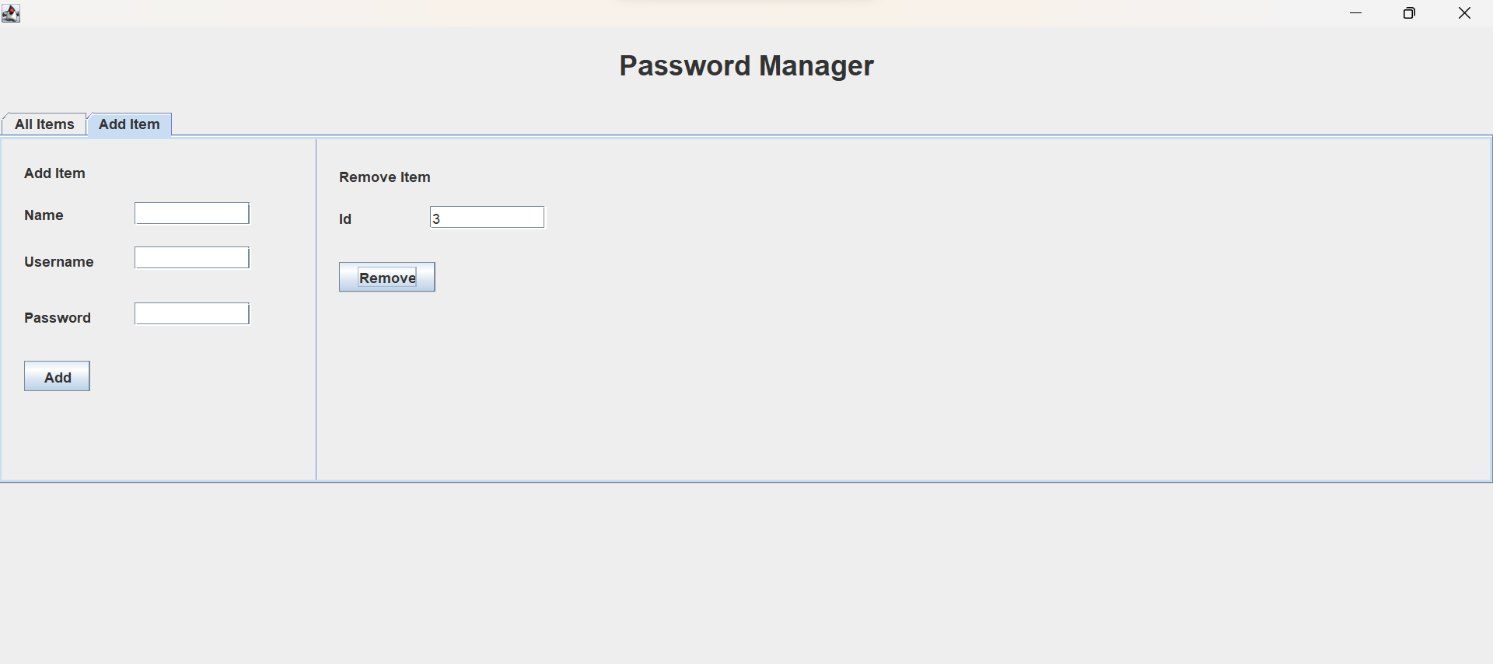
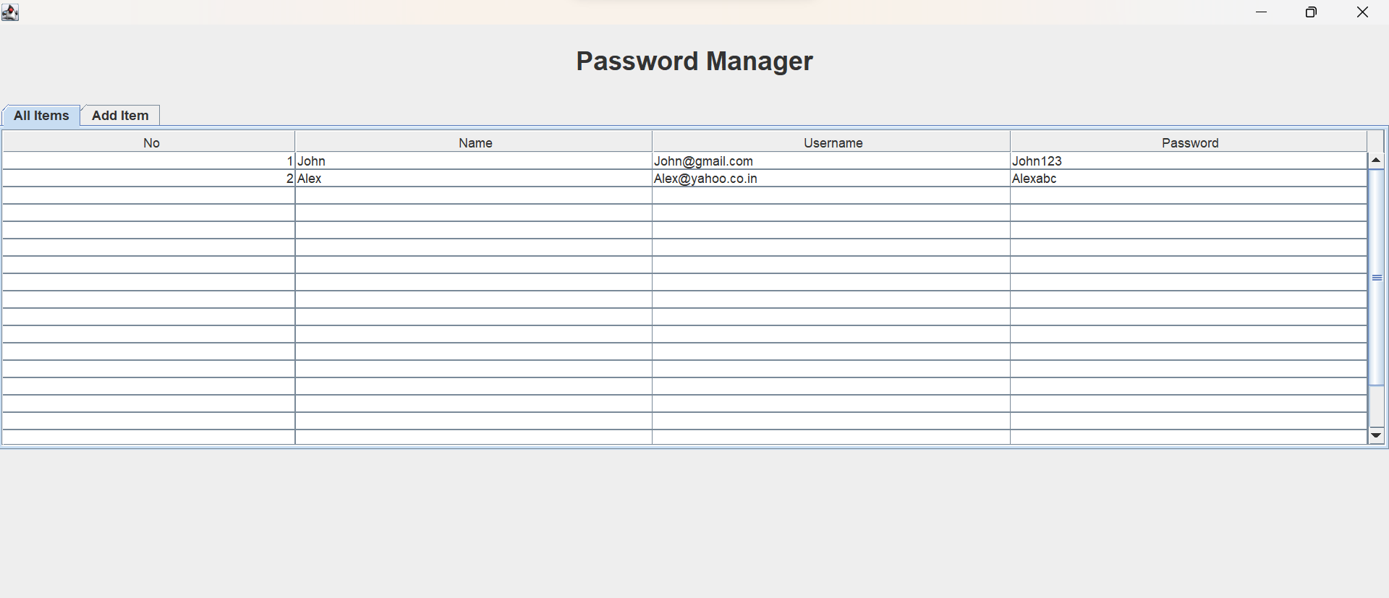
Output :
REMOVE A RECORD
DISPLAYING

Slide 24
THANK YOU.

